Slide 1
Chains and graphs

Slide 2
LLMs are limited
Start
End
LLM
Access to knowledge
Tools
Multi-step processess
…

Slide 3
Therefore, many applications place LLM as one of many steps in the process
Start
...
End
Step 1
LLM
Step N

Slide 4
The flow structure is referred to as a chain
Start
...
End
Step 1
LLM
Step N
Chain (chain)

Slide 5
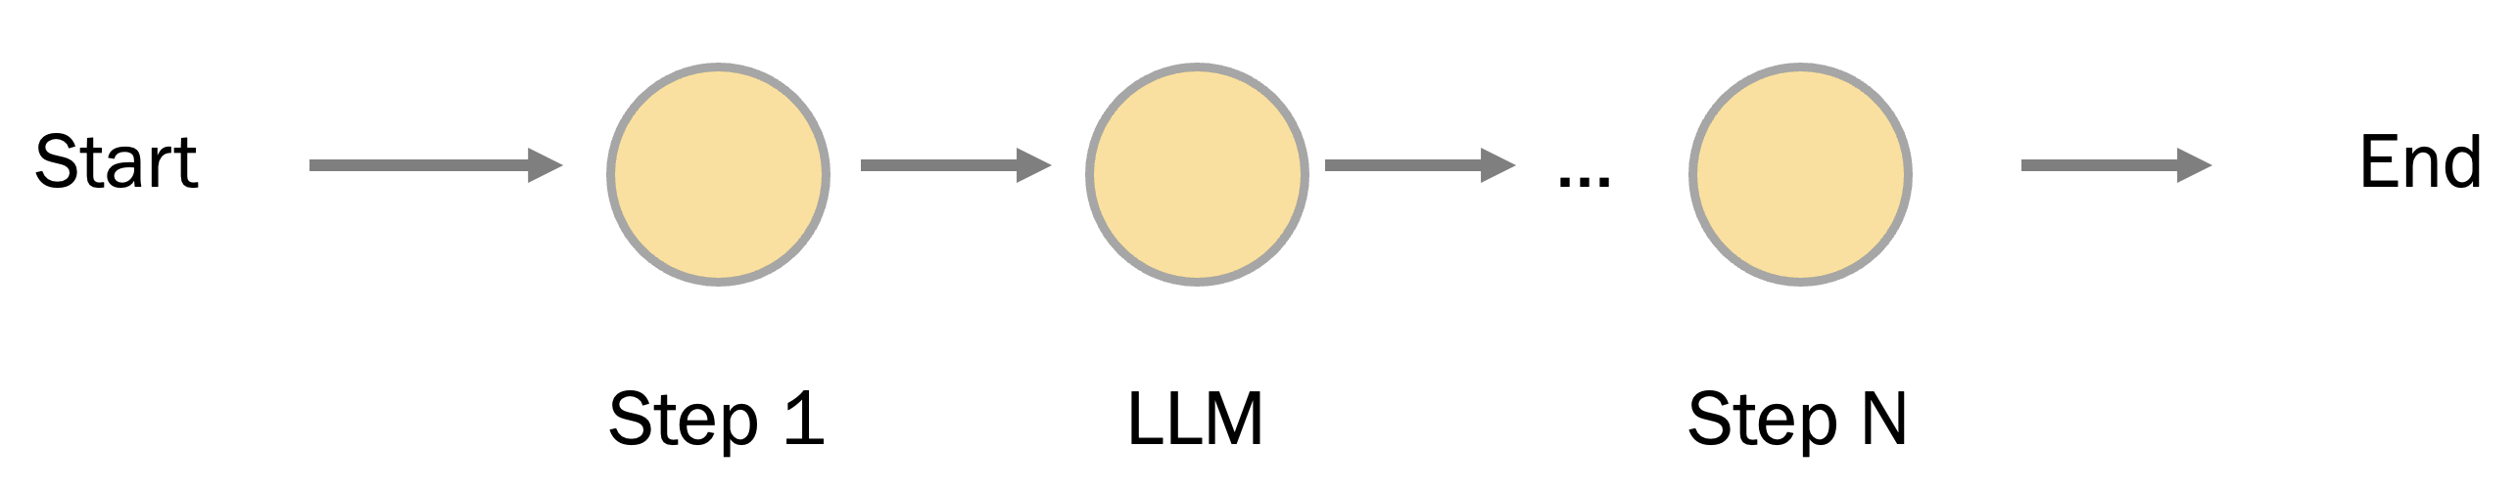
Such flows are predictable
launches
...

Slide 6
Start
End
But we expect Intelligence from AI....
Step 1
Step 2
Step 3
Start
End
Step 1
Step 3
Start
End
Step 1
Step 1
Step 3

Slide 7
Step 1
We can just trust the LLM,
but sometimes it can go wild…
Step 2
...
Step N
Start
End
LLM

Slide 8
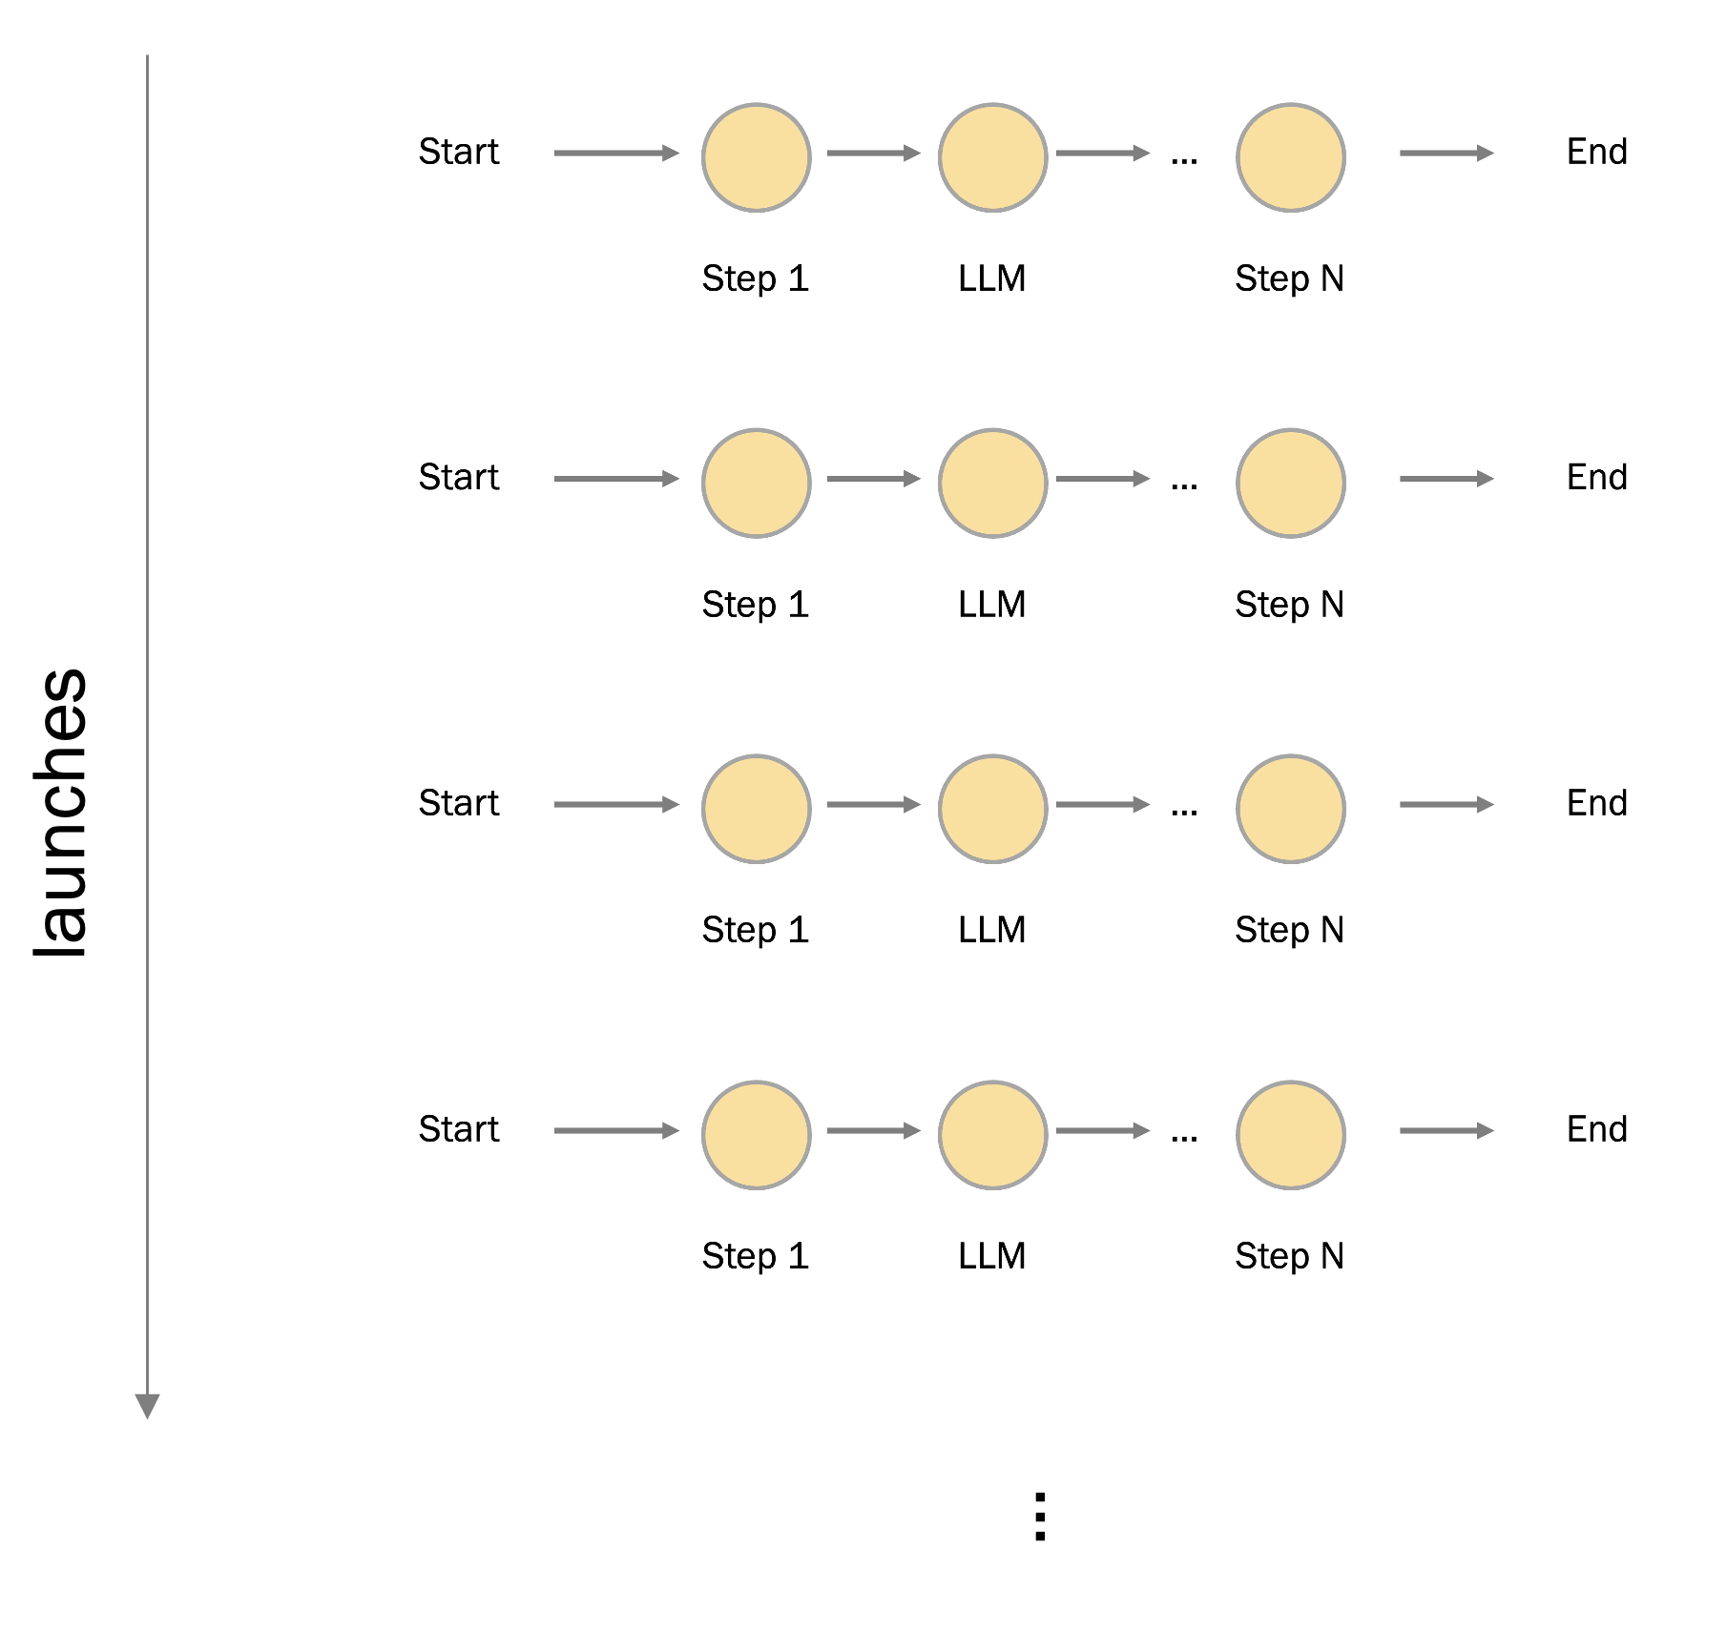
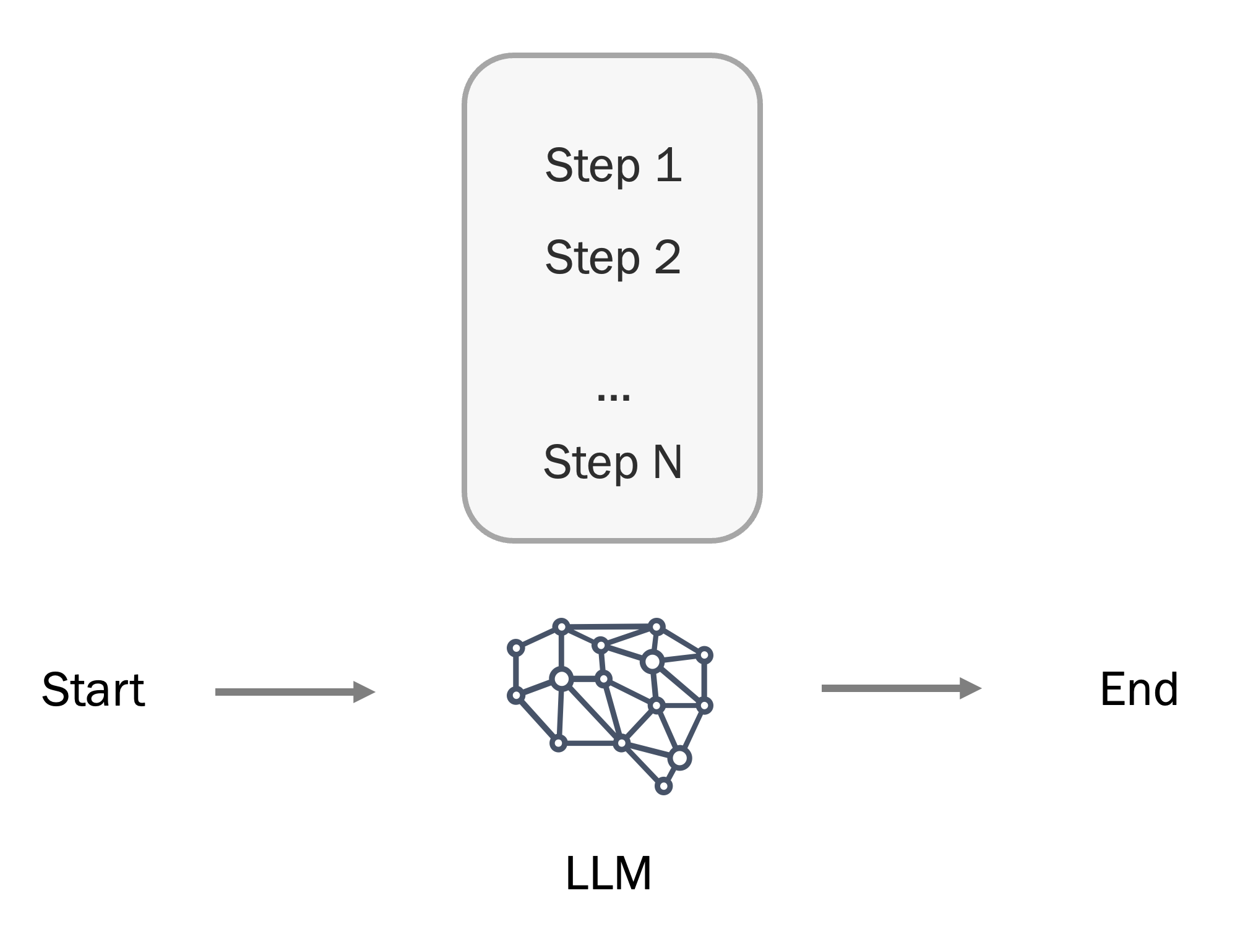
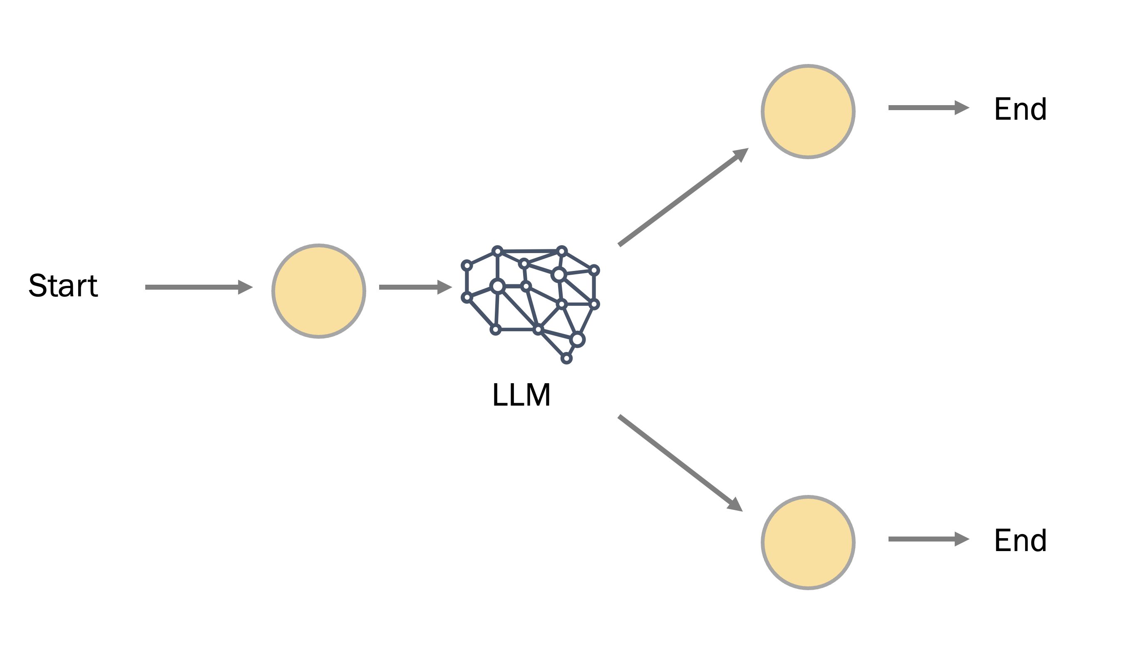
Extremes
Chain
Router
Full autonomy

Slide 9
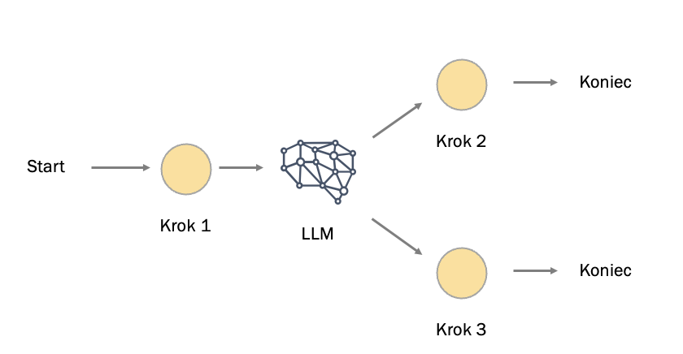
Router
Full autonomy
Graphs help maintain credibility when handing over the reins to AI
The greater the autonomy of the LLM, the lower its credibility....

Slide 10
LLM Applications are pipelines of components and artifacts

Slide 11



Chains
step 1
step 2
...
step n
LCEL
LangChain
Expression
Language
chain = prompt | step_1 | step_2 | step_n | output_parser

Slide 12
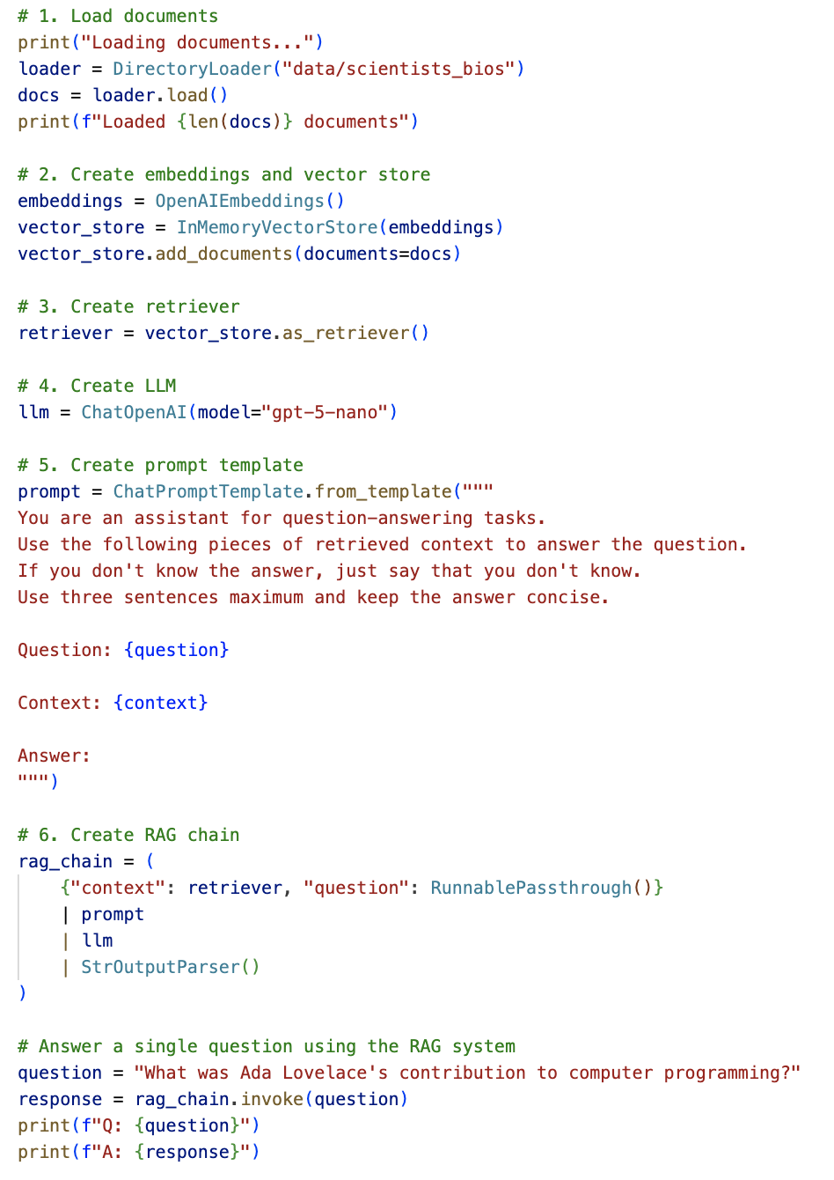
Chains

Slide 13
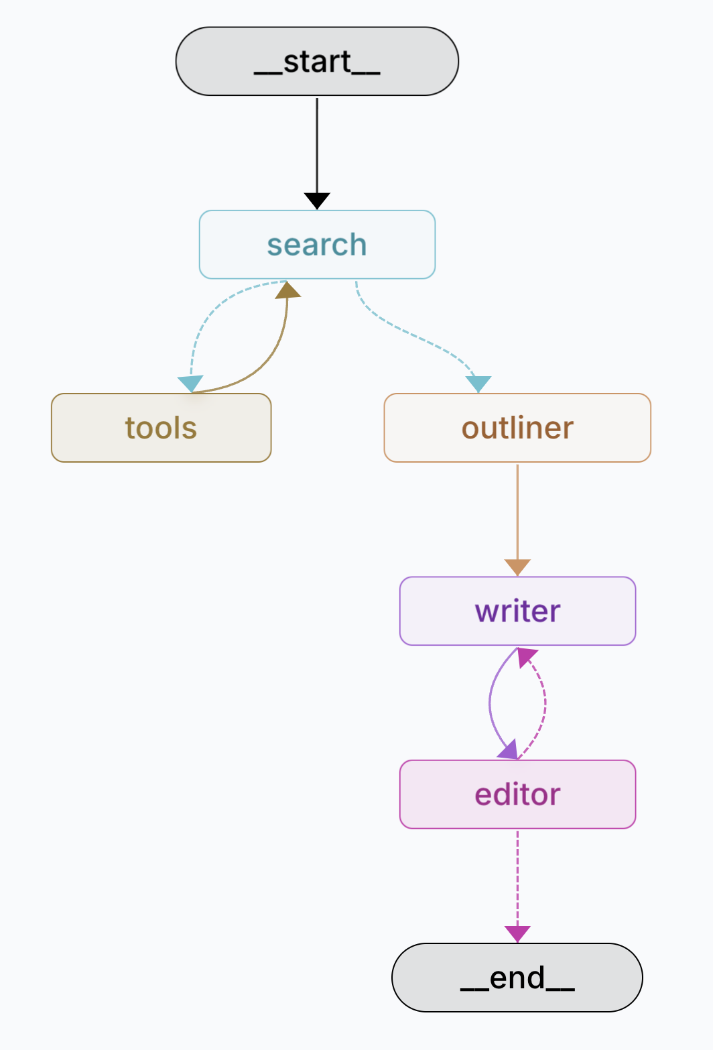
Graphs

Slide 14
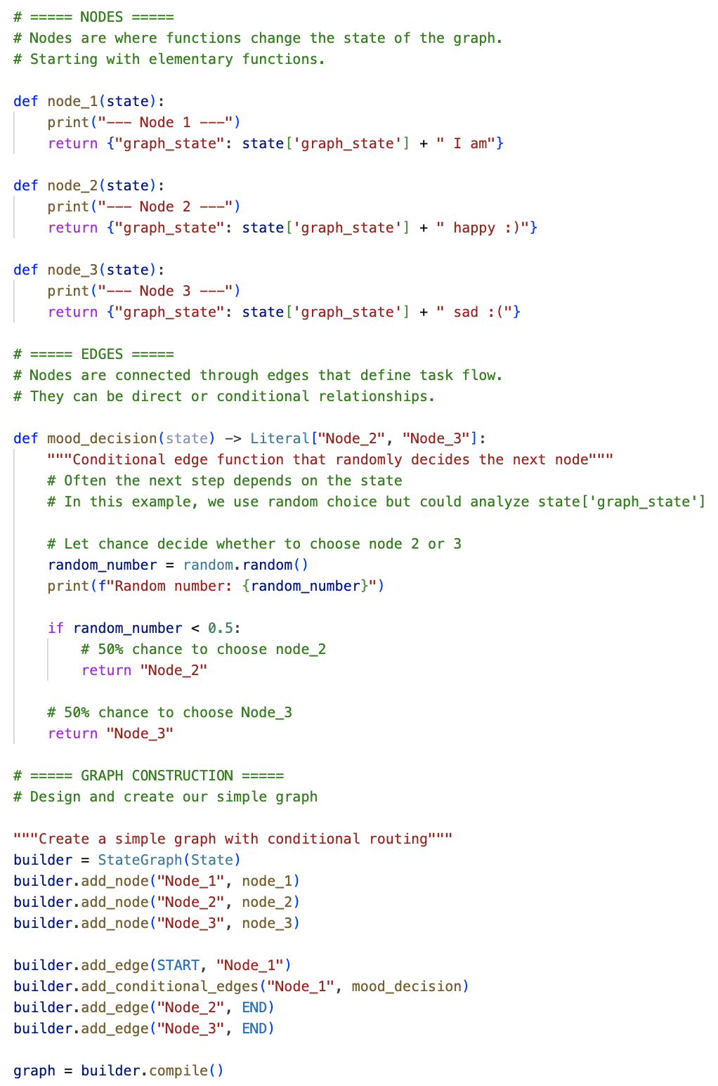
Components can be elementary functions....

Slide 15
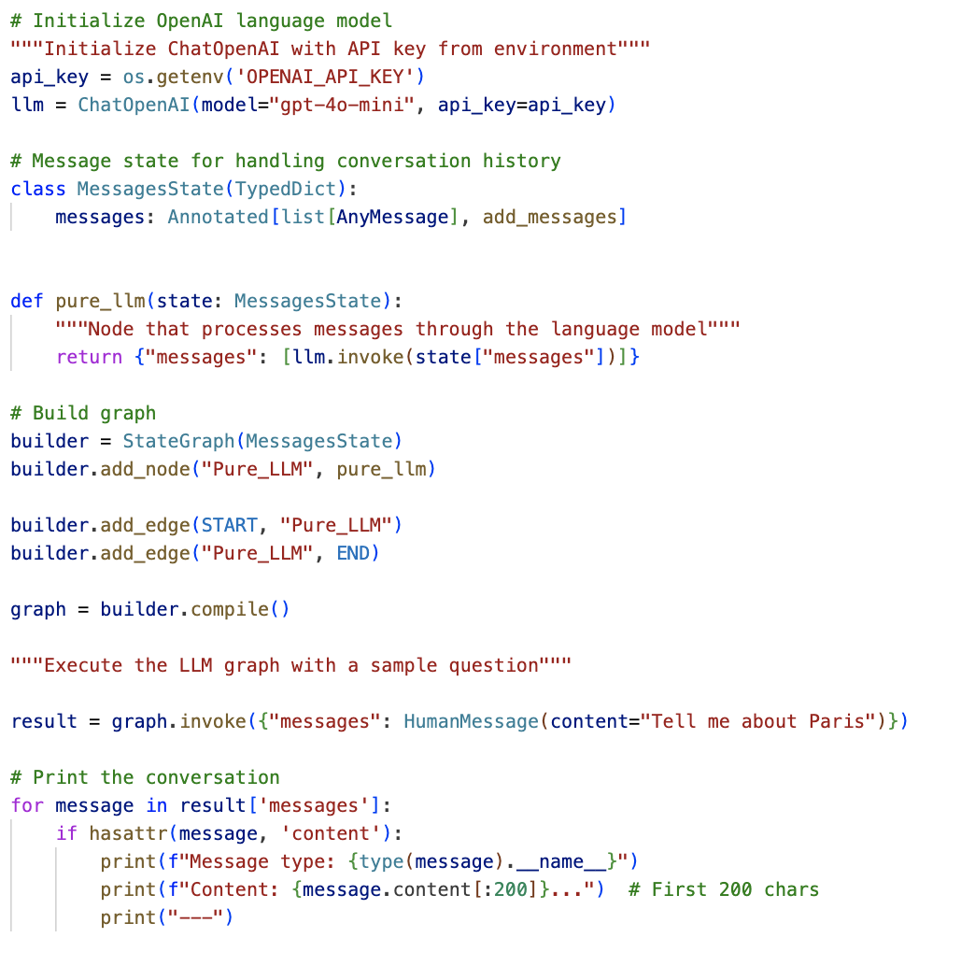
... modules using LLM ...

Slide 16
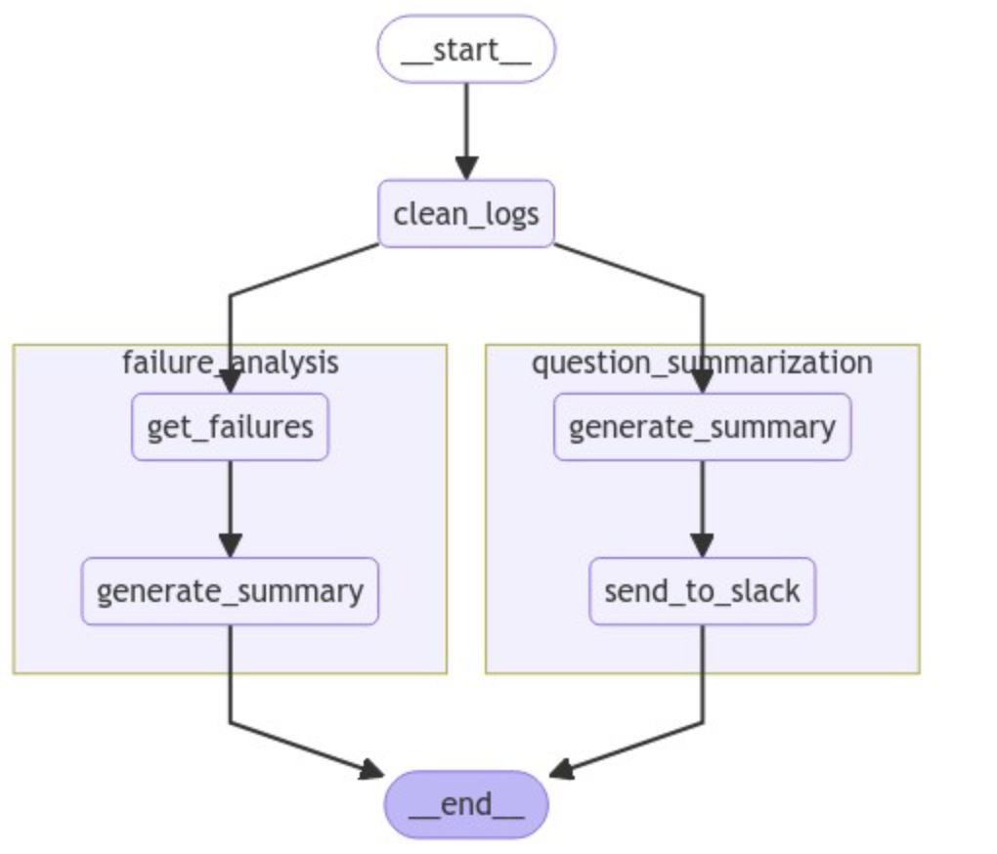
... or other graphs

Slide 17
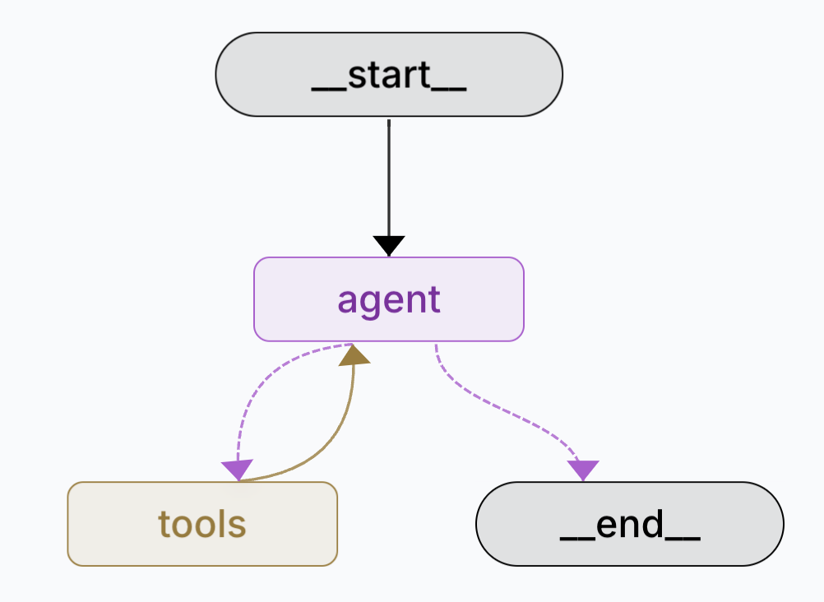




Slide 18


Slide 20
Flow engineering

Slide 21
In a graph, you can include "decision points"

Slide 22
"deterministic”
branches
End
if a = 0: Step 2
else:
Step 3
Step 2
Start
Step 1
End
Step 3

Slide 23
"non-deterministic”
branches
End
Step 2
Start
Depend on the state of the graph or LLM decision
Step 1
LLM
End
Step 3

Slide 24
You can use loops (recurrences)

Slide 25
This forms the basis for reflexive mechanisms
ReAct = Reason and Act
Start
...
End
Step 1
LLM
Step N

Slide 26
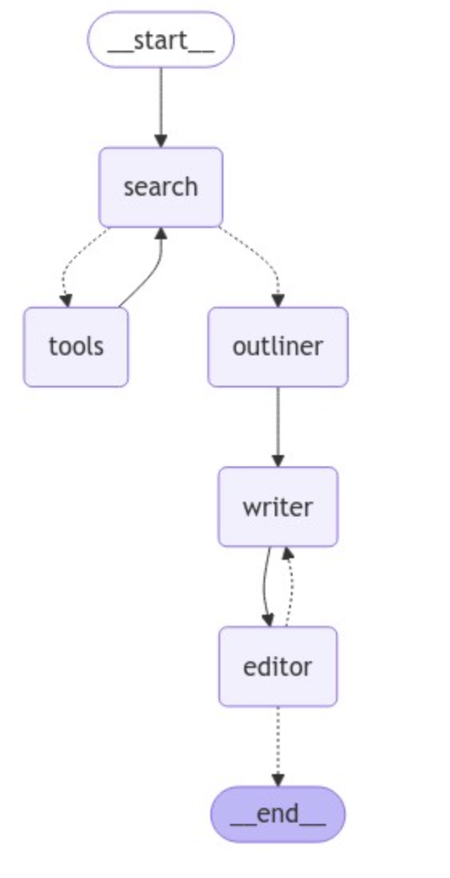
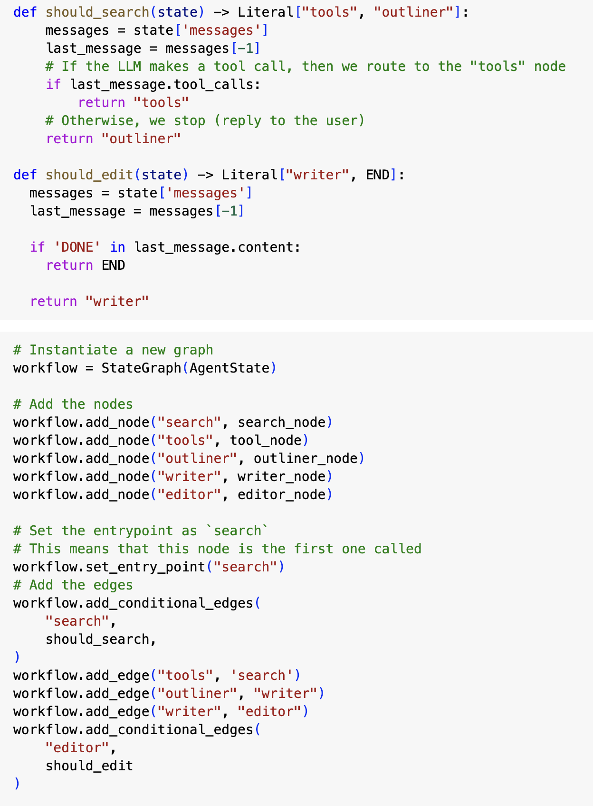

Slide 27
Human can also be included … (Human-in-the-Loop)
Start
...
End
Step 1
LLM
Step N

Slide 28
In a certain situation…
Startup
...
End of
Step 1
LLM
Step N

Slide 29
… or permanently
Startup
...
End of
Step 1
LLM
Step N

Slide 30
Processes in a graph can be branched into multiple parallel threads (MAP > REDUCE)

Slide 31
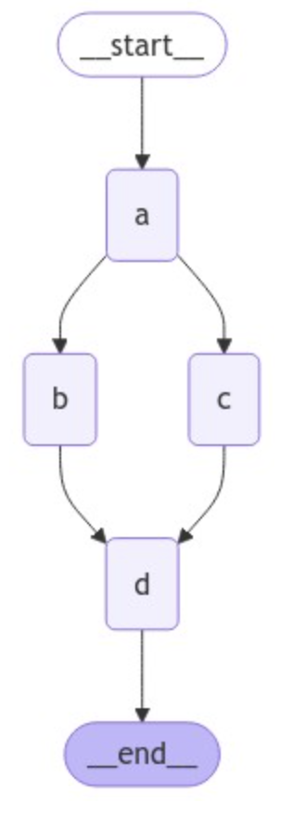
This reduces the response time
and allows the system to scale

Slide 32
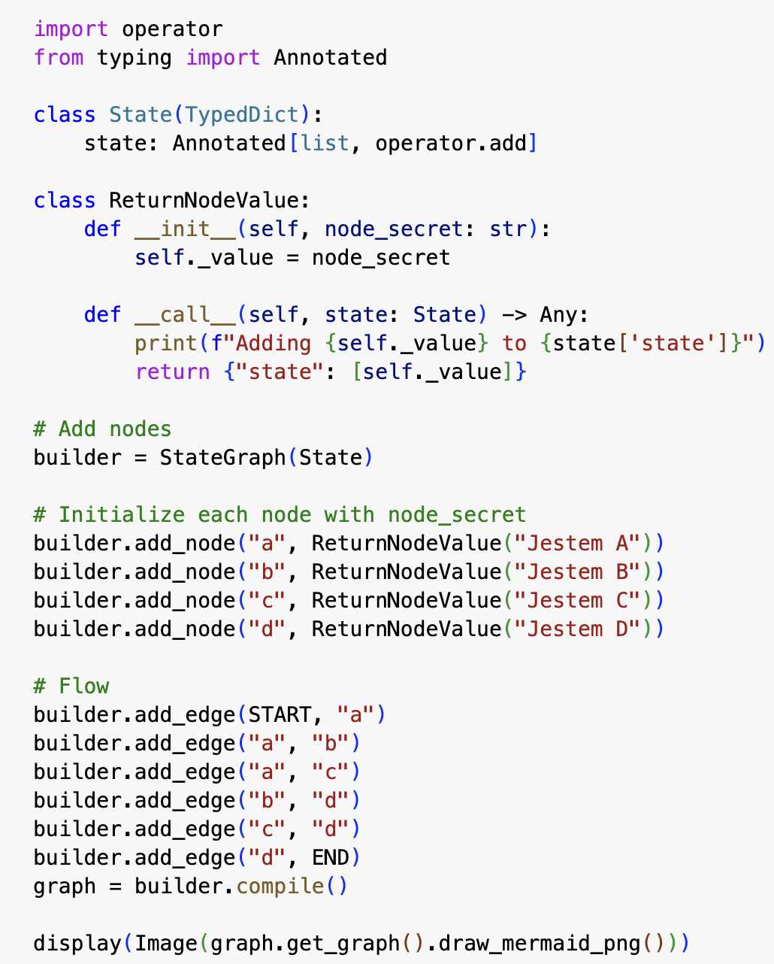

Slide 33
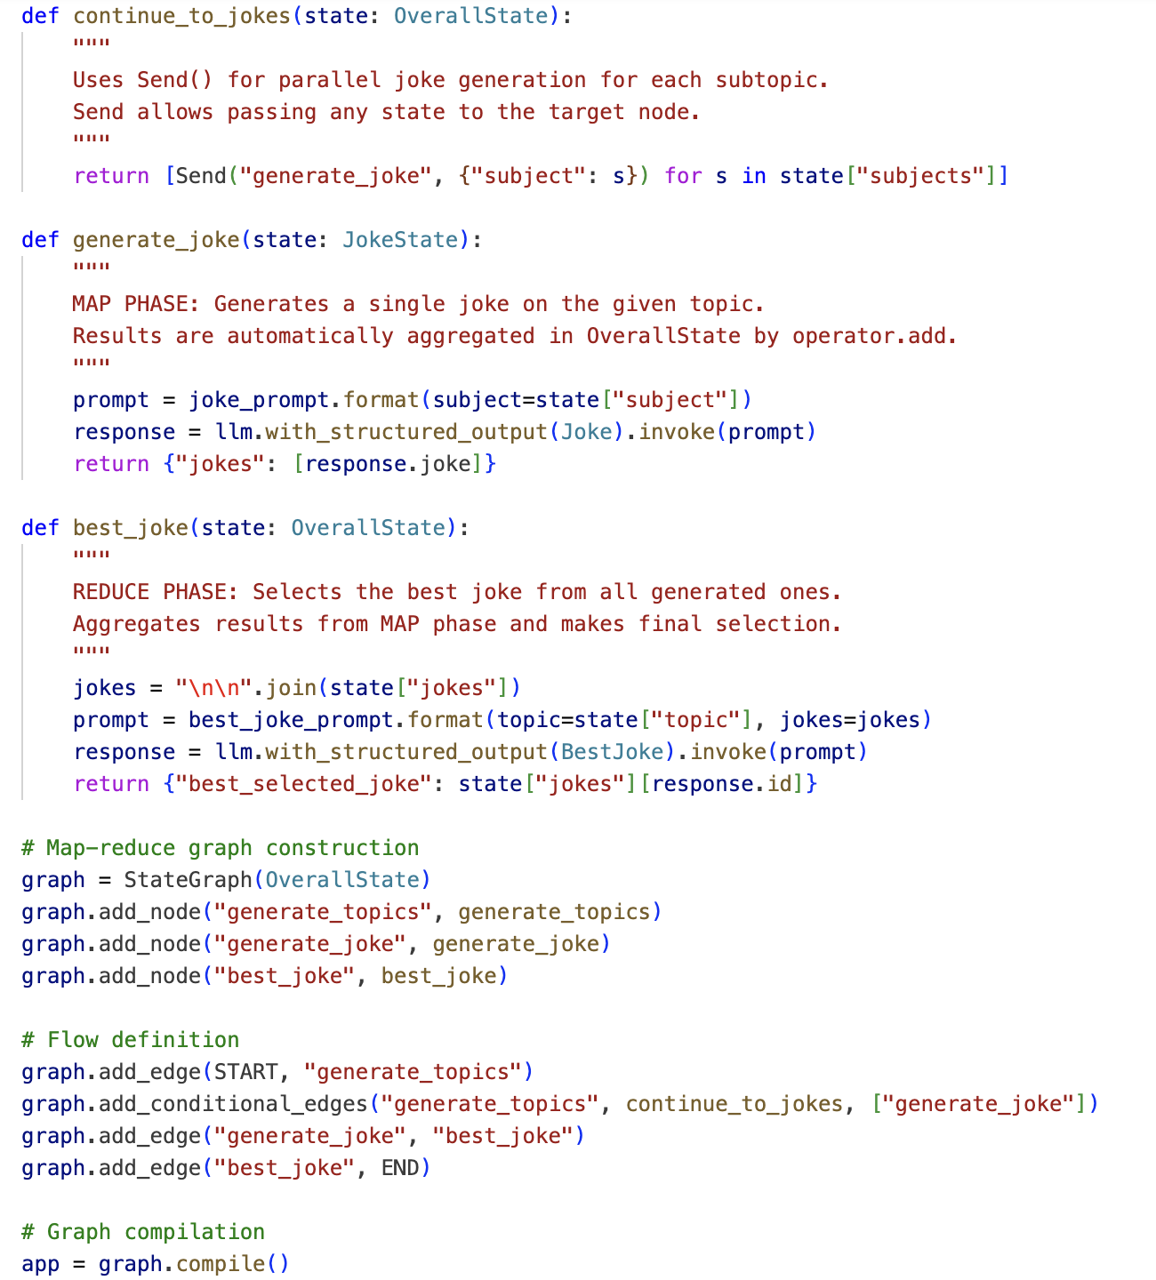

Slide 34
Processes can be composed from multiple subgraphs

Slide 35
__start__
create_analysts
user feedback
Such graphs can perform separate tasks.
They are often referred to as agents
__start__
ask question
search wikipedia
search internet
answer the question
save the interview
write the section
write summary
write report
write introduction
finalize report
__end__

Slide 36
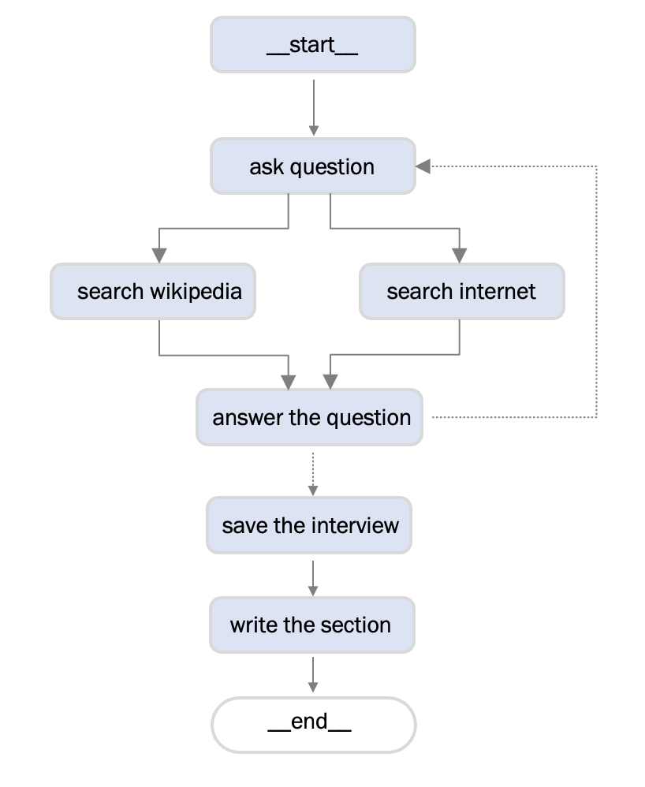
Any such agent may have a private state....

Slide 37
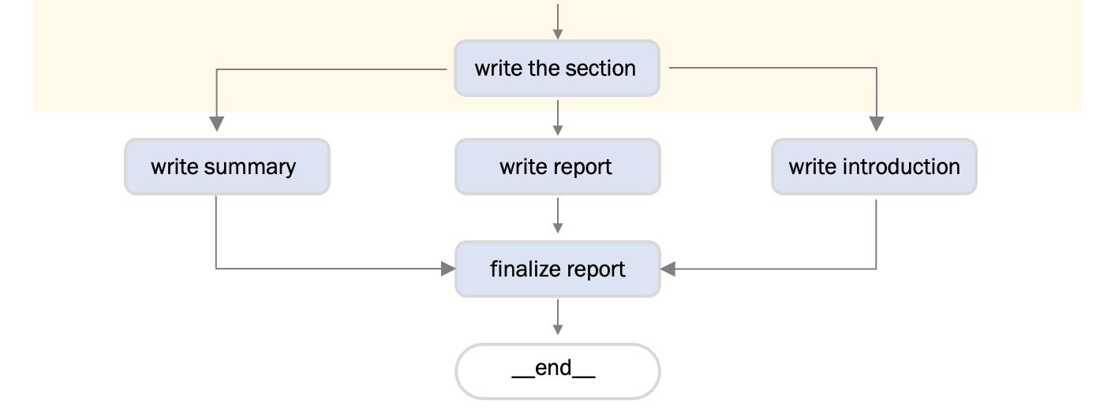
... And have access to the public state

